Slide 1
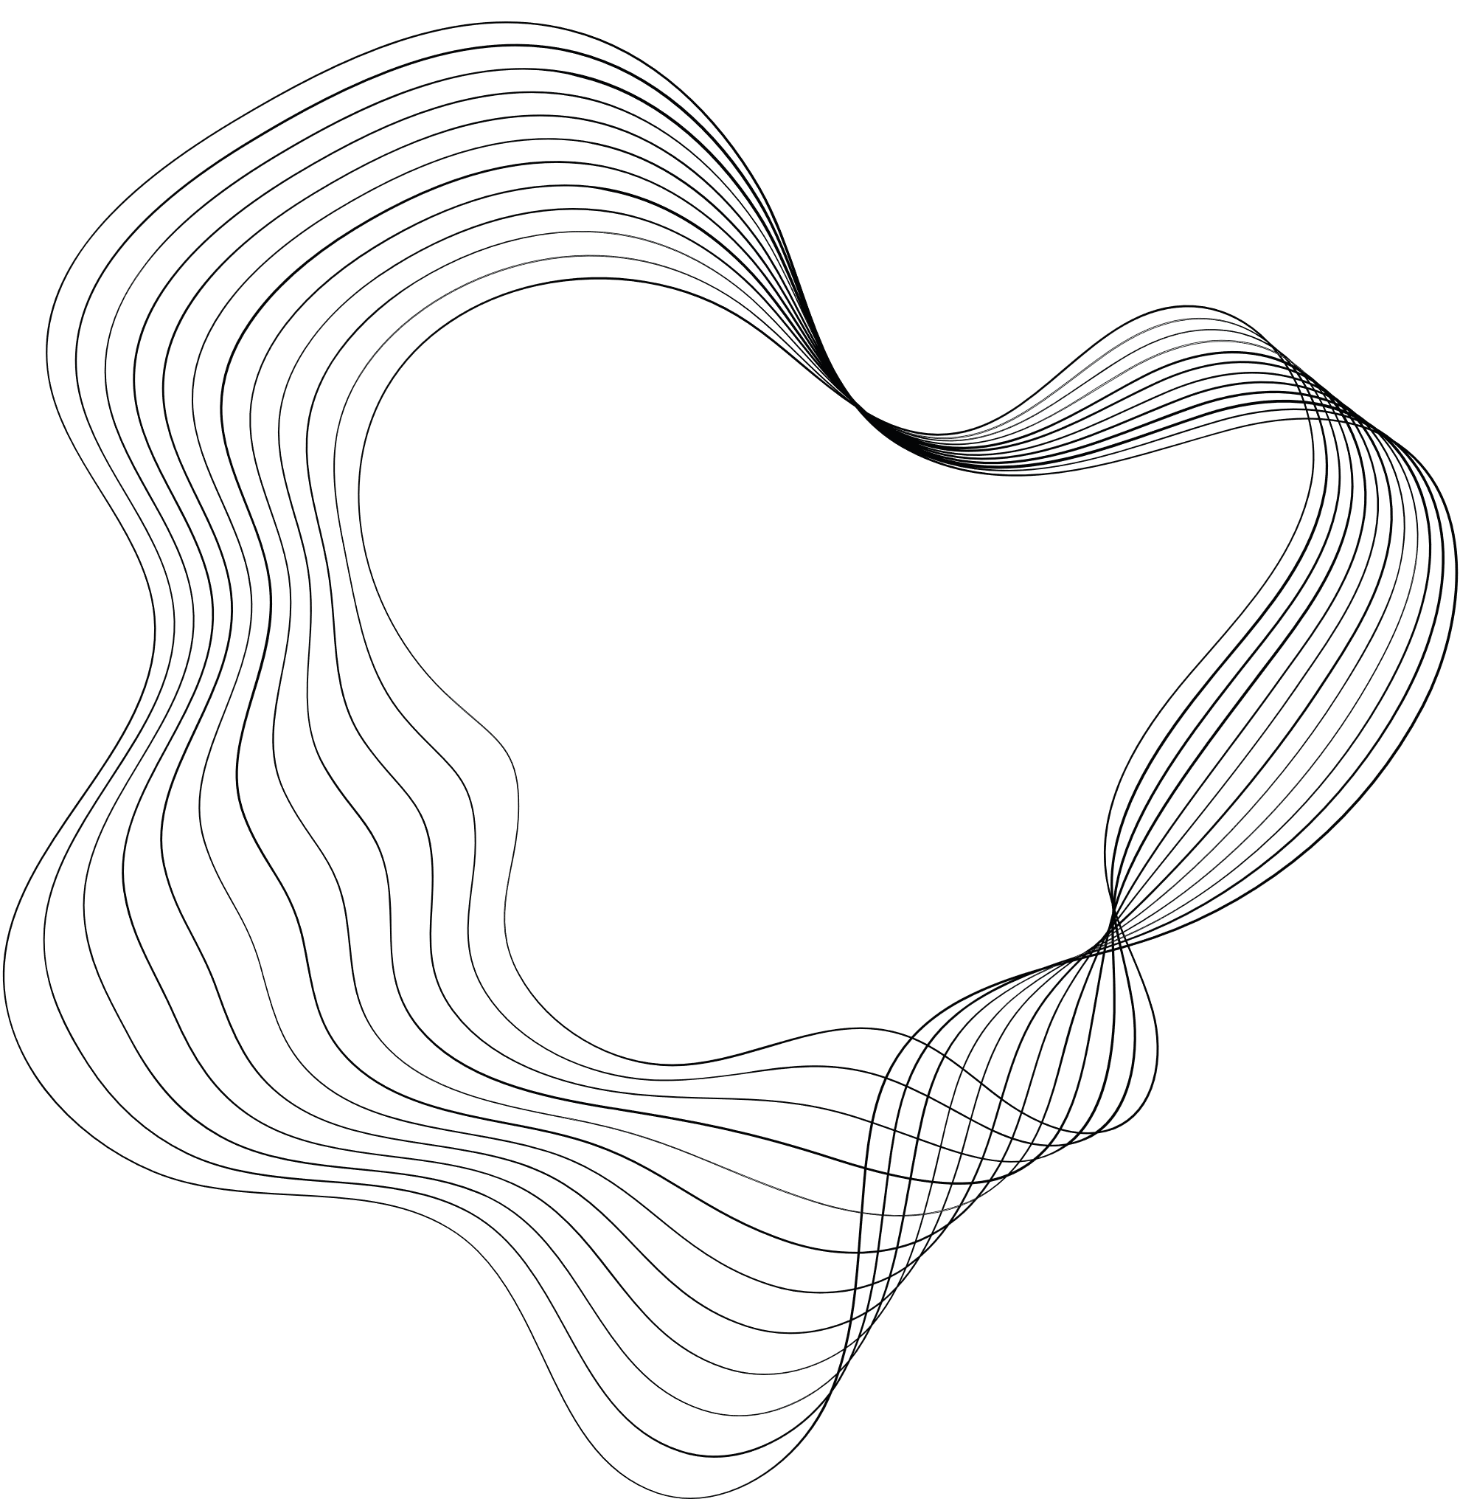


FINAL PROJECT
A CLOUD-BASED FINANCIAL SAAS PLATFORM
XINGDONG (SHELDON) LI, JIAWEI ZOU

Slide 2

CONTENT
01
INTRODUCTION
02
SYSTEM DESIGN
03
DEMO
04
CHALLENGES & REFELCTIONS
05
NEXT STEPS & DELIVERABLES
Notes:
We'll begin with a brief introduction to our project, outlining the application's purpose and the specific needs it addresses. Next, we'll discuss the system design, explaining the architecture and key components. We'll then walk through the development process, highlighting the challenges we faced and how we overcame them. Finally, we'll explore potential features that could be integrated into the application in the future.

Slide 3





INTRODUCTION
Type: Web-based accounting application
Need: Helps users track and record every penny spent
Third-Party: Use Plaid-API for tracking bank statements and monitor income.
Infrastructure: All other functionalities, including database, are powered by AWS
Key Features:
Detailed Expense Tracking and Categorization
Income/Expense Visualization
Weekly/Monthly Reports
Notes:
This project aimed to build a web-based application which helps people track their spending and manage where their money goes. We used a third-party API called Plaid to simulate bank accounts and generate fake transactions. For the cloud infrastructure, essential components like user authentication and database are powered by AWS. Since our goal was to create a Minimum Viable Product (MVP), we focused on implementing a few key features, such as expense tracking, visualization, and financial reports.

Slide 4


GOALS AND OBJECTIVES
Connect Account
Tracking
Visualization

Slide 5

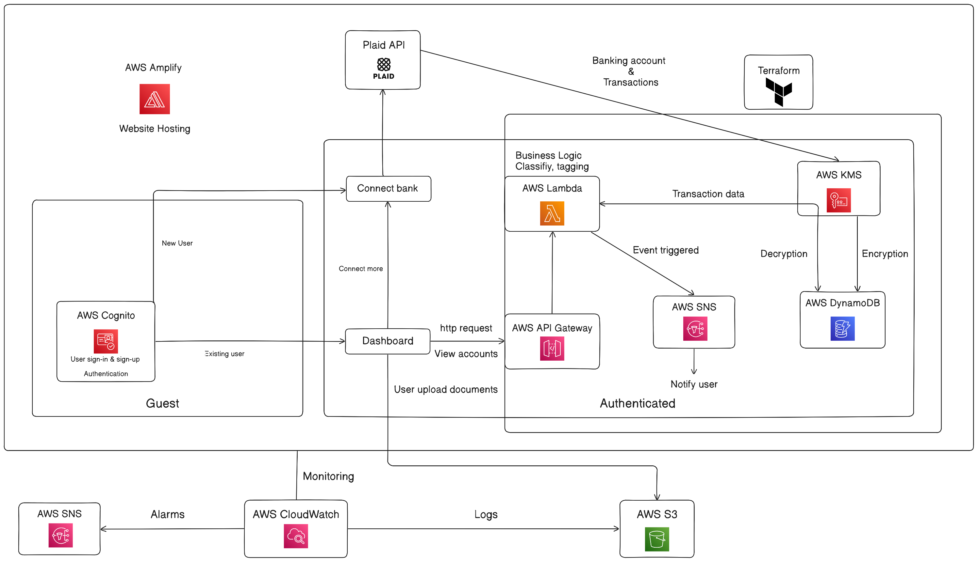
SYSTEM DESIGN
Notes:
This is our system design diagram. We use AWS Cognito for user authentication, including sign-up and log-in. The website is hosted using Amplify and Terraform. Plaid connects simulated bank accounts to user accounts, with income and expense records stored in DynamoDB. For user interactions, we utilize AWS API Gateway and AWS Lambda to dynamically handle page navigation. AWS CloudWatch is employed for application monitoring and maintenance.

Slide 6
DEMO
Demonstration
Notes:
Our development journey began with building the frontend logic using Next.js. We aimed to seamlessly integrate the Plaid API to connect simulated bank accounts with user accounts. However, we encountered unforeseen bugs during the integration process. To resolve this, we made the decision to switch from Next.js to React, which allowed us to successfully implement Plaid’s functionality.
Once the frontend was stabilized, we moved on to setting up user authentication using AWS Cognito. While configuring sign-up and log-in processes, we faced connectivity issues that disrupted the user flow. After careful troubleshooting, we implemented [method TBD], which resolved the issues and ensured a smooth authentication experience.
Finally, we hosted our application on AWS Amplify, but soon encountered persistent npm build failures. This led us to migrate our hosting environment to Terraform, which provided a more reliable and stable platform for our build and deployment processes. Throughout these stages, we utilized AWS API Gateway, Lambda for page navigation, and DynamoDB for storing financial data, with AWS CloudWatch monitoring the entire application."

Slide 7


CHALLENGES
Plaid API
Encountered bugs beyond our expertise in Next.js, so we switched to React for a successful connection.
Auth (AWS Cognito)
Faced connection issues with AWS Cognito; resolved using Amplify CLI, a AWS-managed library
Terraform Deployment
Manage the resources is tricky when increasing the number of resources
Notes:
During our development, we encountered a few key challenges. First, integrating the Plaid API with our Next.js application proved difficult due to unforeseen bugs. We resolved this by switching to React, which allowed for a successful connection.
Next, we faced issues with AWS Cognito, where the connection was unstable. We tackled this by implementing [method TBD], which stabilized the authentication process.
Lastly, while hosting our project on Amplify, we encountered npm build failures. This prompted us to migrate to Terraform, which provided a more reliable environment for our build and deployment process.

Slide 8
AWS SERVICES USED
AWS Amplify for deployment and hosting
AWS Cognito for authentication
AWS Lambda for backend logic
AWS DynamoDB for data storage
AWS API Gateway for WebSocket
AWS KMS for data encryption
AWS SNS for notifications
AWS CloudWatch for monitoring
AWS S3 for static asset storage
AWS CloudFront for CDN

Slide 9

THANK'S FOR WATCHING

